Slide 1



PET BENEFITS
YOU AND YOUR PETS WILL LOVE
TOTAL PET PLAN + WISHBONE
brought to you by Pet Benefit Solutions

Slide 2


YOUR PET BENEFIT OFFERINGS
Pet care bundle offering
discounts on services and
everyday pet care products
Reimbursement plans
for accidents, illnesses,
and wellness care
Maximize your pet care savings by enrolling in both plans!
Pet Benefit Solutions | www.petbenefits.com

Slide 3


WHY PET BENEFITS

Slide 4
PETS ARE FAMILY
Your pets are part of your family, and you’ll do anything to keep them happy and healthy.
45% of pet parents spend as much or more money for their pets' health expenses as their own
65% of pet owners spoil their pets daily, with over half spoiling their pets "24/7"
44% of pet owners celebrate their pet's birthday with a birthday bash
BPM
Zesty Paws
Zesty Paws
Pet Benefit Solutions | www.petbenefits.com

Slide 5


PET CARE COSTS GREW ~70% IN TWO YEARS
$800-$1500
average emergency vet bill
$2000
average spent per pet per year (not including emergencies)
It's harder than ever to afford quality veterinary care –
with 63% of pet parents not prepared for a
$500 emergency expense
Global market insights from 2020-2022, CNBC
Pet Benefit Solutions | www.petbenefits.com

Slide 6
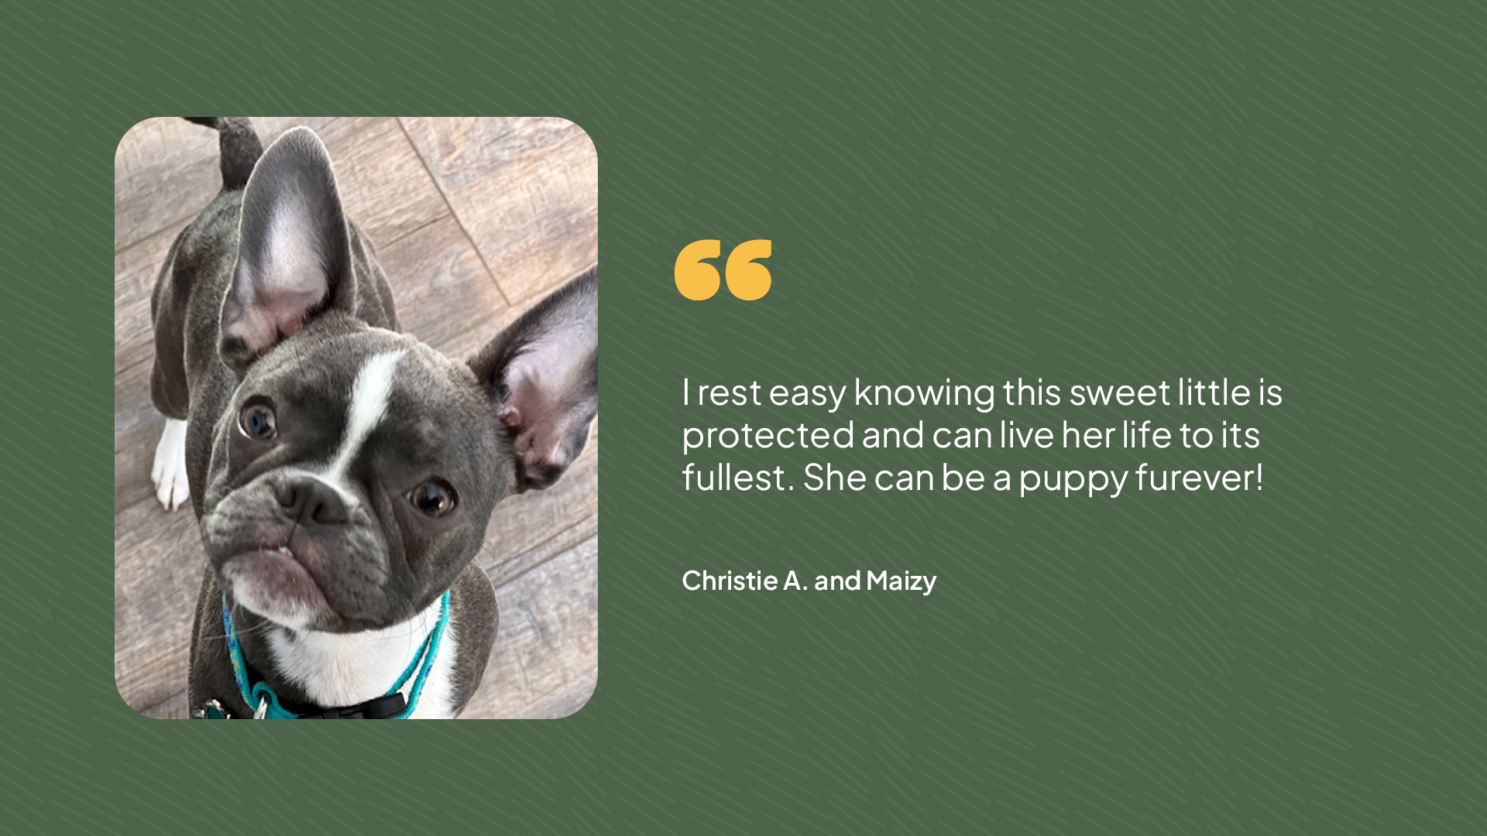
Pet Benefit Solutions | www.petbenefits.com

Slide 7

TOTAL PET PLAN
Get your paws on real pet care savings

Slide 8


TOTAL PET PLAN PET CARE BUNDLE
Comprehensive package offers savings on everything your pet needs
No exclusions based on breed, age, or pre-existing health conditions
Low cost, even if you have multiple pets
Flat rates regardless of age, breed or zip code – a family plan covers all the pets in your home
Can be used alongside pet insurance
Pet Benefit Solutions | www.petbenefits.com

Slide 9
TOTAL PET PLAN COVERAGE DETAILS
Our pet care bundle includes coverage on everything pets need:
DISCOUNTS ON PRODUCTS & PRESCRIPTIONS
DISCOUNTS ON VETERINARY CARE
24/7 PET TELEHEALTH
LOST PET RECOVERY SERVICE
DISCOUNTS AT PET RETAILERS & SERVICE PROVIDERS
Pet Benefit Solutions | www.petbenefits.com

Slide 10
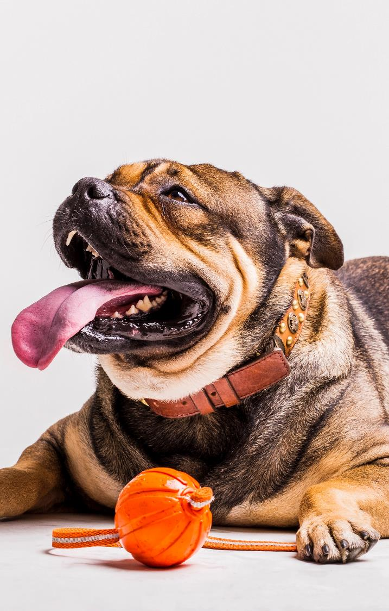
TOTAL PET PLAN
DISCOUNTS ON
PRODUCTS & PRESCRIPTIONS
Receive members-only pricing (up to 40% off) on your pet’s prescriptions, preventatives, food, treats, and more
Shipping is always free
Most prescriptions can be picked up at participating pharmacies, including CVS, Walmart, and other independent CVS Caremark® pharmacies
All dogs and cats are eligible, regardless of age, breed or health
Pet Benefit Solutions | www.petbenefits.com

Slide 11
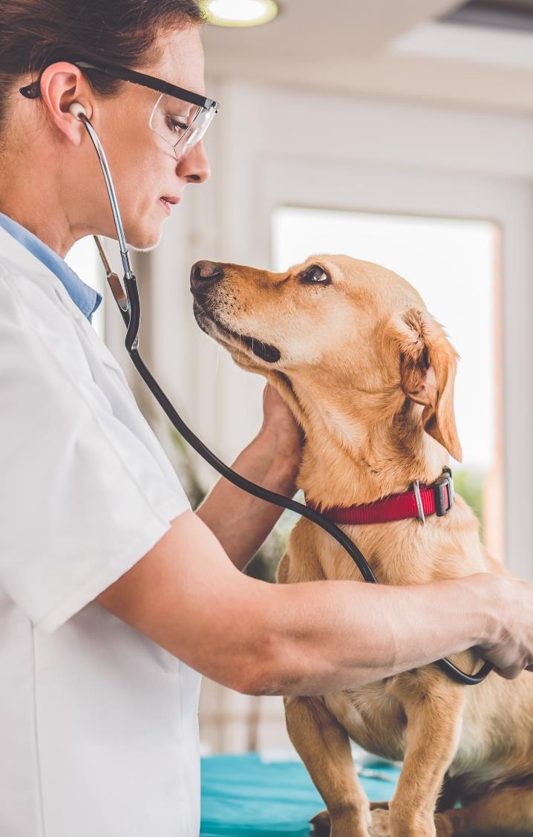
DISCOUNTS ON VETERINARY CARE
TOTAL PET PLAN
25% savings on all in-house medical services at network veterinarians
Show your ID card at the time of service and receive an instant discount
All pets are eligible, even elderly pets and pets with pre-existing conditions
Participating veterinarians in all 50 states and Puerto Rico

Slide 12
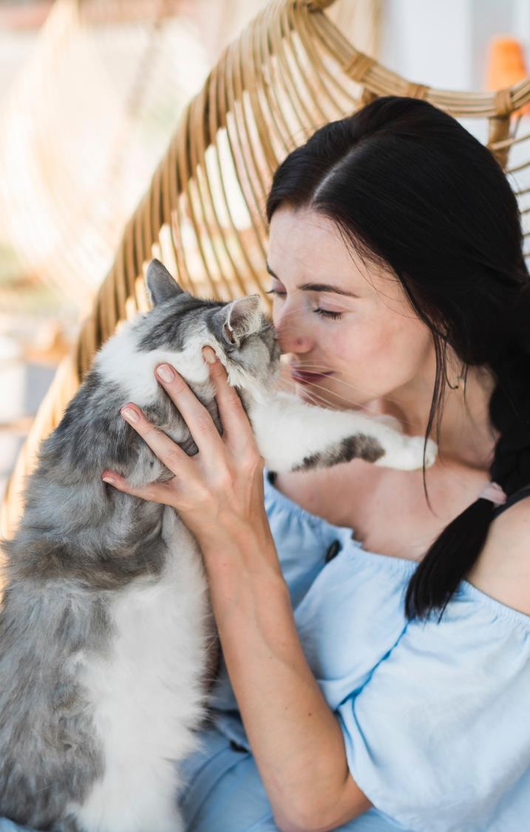
24/7 PET TELEHEALTH
TOTAL PET PLAN
Connect with a vet 24 hours a day
Staffed exclusively by licensed veterinarians
Receive answers to urgent questions about your pet’s health, wellness, behavior and more
Reduces unnecessary vet visits
No out-of-pocket costs or extra fees
Pet Benefit Solutions | www.petbenefits.com

Slide 13

LOST PET RECOVERY SERVICE
TOTAL PET PLAN
All pets with a collar are eligible to receive an ID tag
If your pet goes missing, the finder scans the tag to access the information you provide in your online profile
No special scanners necessary, just a smartphone
Instantly update contact information online, even after your pet goes missing

Slide 14

DISCOUNTS AT PET RETAILERS AND SERVICE PROVIDERS
TOTAL PET PLAN
Exclusive discounts on subscription boxes, high-end pet products, pet sitting, and more
Easy to access from the Pet Benefit Solutions member portal
Complements other discounts and services provided through Pet Benefit Solutions
Pet Benefit Solutions | www.petbenefits.com

Slide 15
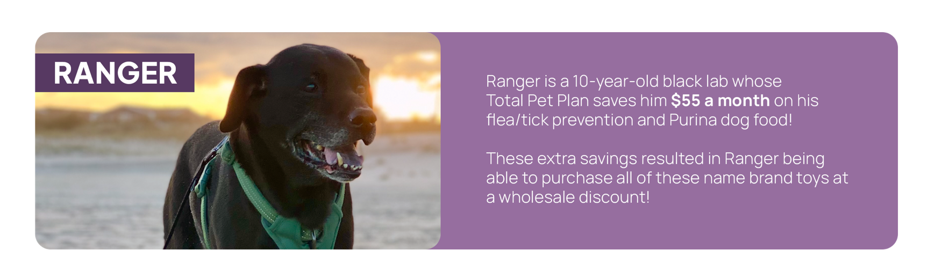
TOTAL PET PLAN
SAVES THE DAY
Pet Benefit Solutions | www.petbenefits.com

Slide 16

WISHBONE
Your best friend. Their best life.

Slide 17
WISHBONE INSURANCE AND WELLNESS
WISHBONE
Two reimbursement plans available
ADVANTAGE PLAN: For unexpected accidents & illnesses
WELLNESS PLAN: For regular routine visits
Pet Benefit Solutions | www.petbenefits.com

Slide 18
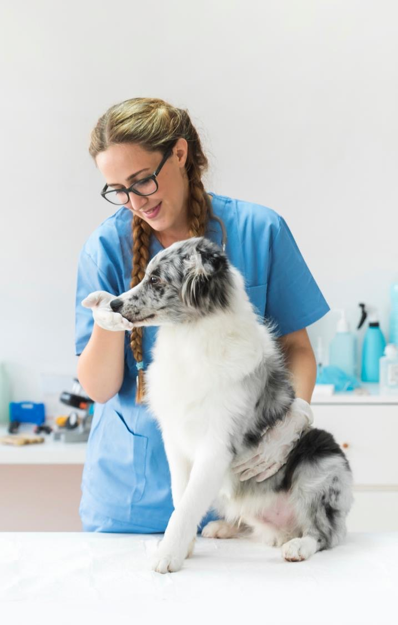
BEST-IN-CLASS COVERAGE ACCIDENT/ILLNESS & WELLNESS
WISHBONE
Can be used at any veterinary facility in the U.S., including specialty and emergency clinics
Covers dogs older than 8 weeks of age and cats older than 10 weeks of age, with no upper age restriction
Easy claims submission with fast processing
ACH reimbursement directly to your bank account
Enter your credit card during enrollment, which will be charged for monthly premiums
Easy online access to your account
Dedicated customer care team
Wishbone Pet Insurance is a pet health insurance program offered by Pet Assure Corp., dba Pet Benefit Solutions, a licensed agency (NJ License Number 1677880). Insurance coverage is administered by Pet Benefit Solutions or Norse Specialty Insurance Company, Inc. and underwritten by Everspan Insurance Company, Providence Washington Insurance Company, Trisura Insurance Company, Clear Blue Insurance Company, or Clear Blue Specialty Insurance Company. Please visit https://www.wishboneinsurance.com/terms-and-conditions for more information.

Slide 19
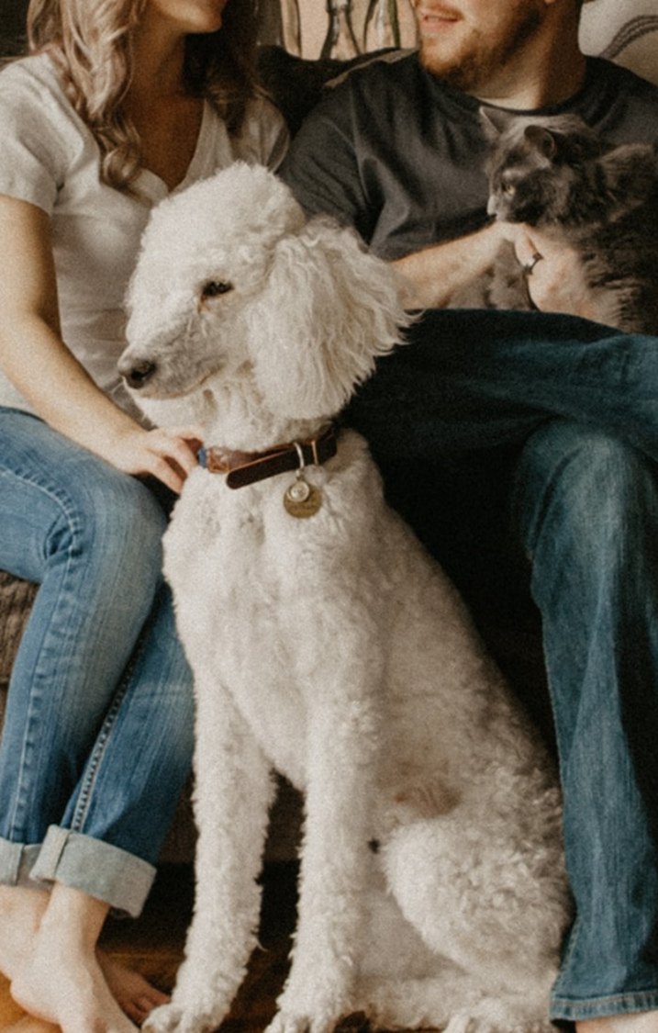

WISHBONE ADVANTAGE PLAN DETAILS
WISHBONE
Reimbursement on exam fees, diagnostics, and treatment due to eligible accidents and illnesses:
Rx medications, surgery, emergency visits and hospitalizations, x-rays, physical therapy, infections, allergies, and more
Pre-existing conditions are excluded
Short waiting periods begin the day after enrollment
1 day for accidents, 14 days for illnesses, and 180 days for orthopedic events
30-day free look period
Includes 24/7 pet telehealth
Rates are based on age, breed and zip code
Exclusive group benefit pricing
Additional 5% discount available when you enroll 2+ pets
Risk-free cancellation terms and waiting periods may vary based on state regulations. Policies exclude pre-existing conditions and are subject to waiting periods, deductibles, co-insurance, benefit limits, and exclusions. Product offerings, rates, and discounts are subject to change and approval. Product information is descriptive; consult your policy for specific coverage details. Terms vary by state and are subject to change. Coverage is determined by the applicable policy. Not all options are available to all customers. In case of conflict, policy provisions prevail.

Slide 20

WISHBONE ADVANTAGE HOW IT WORKS
WISHBONE
Wishbone Advantage is the only pet insurance plan that uses a veterinary network to bring you more savings.
Show your in-network ID card at an in-network vet to receive:
In-Network Bonus: An additional 10% reimbursement on covered expenses
Instant Discount: 25% off eligible in-house medical services at in-network vets (savings applied at time of service)
NOTE: You still have the freedom to visit any licensed U.S. veterinarian -- there’s no network restriction with Wishbone Advantage. You simply get bonus savings if you go in-network!
For more information on Wishbone Advantage, please visit https://www.wishboneinsurance.com/terms-and-conditions.

Slide 21
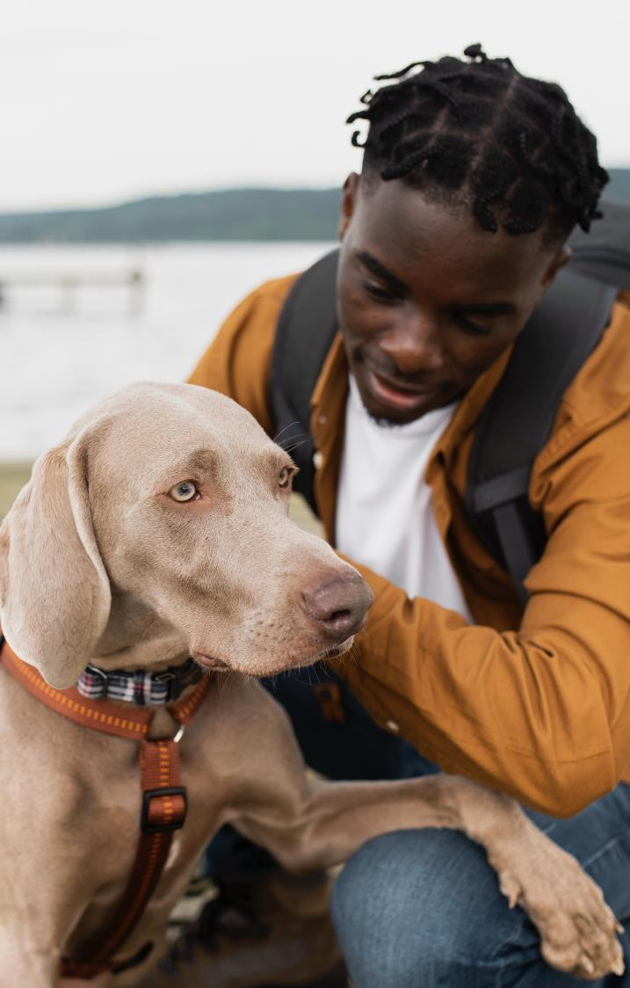

WISHBONE
WISHBONE WELLNESS
PLAN DETAILS
Reimbursement on eligible veterinary care related to wellness visits, including:
Exam fees, vaccinations, routine bloodwork, fecal tests, urinalysis, preventatives, and dental cleanings
ACH reimbursement directly to your bank account
No accident or illness coverage required to enroll
Up to 48% savings on wellness care
Not insurance; quick and efficient claims process
Flat rates regardless of age, breed, or zip code
Wishbone’s wellness plans are not insurance and are administered by Pet Benefit Solutions. Please read our Member Agreement (https://wishboneinsurance.com/wellness) to review full coverage details.

Slide 22
WISHBONE
WISHBONE WELLNESS PLAN OPTIONS
ESSENTIAL
Wellness Exam | 1 per year, up to $50
Vaccination/Titer | 2 per year, up to $50
Routine Bloodwork | 1 per year, up to $100
Fecal Test | 1 per year, up to $50
Urinalysis | 1 per year, up to $50
Preventatives | -
Dental Cleaning | -
TOTAL ANNUAL BENEFITS | $300
PREMIUM
Wellness Exam | 2 per year, up to $100
Vaccination/Titer | 3 per year, up to $75
Routine Bloodwork | 1 per year, up to $100
Fecal Test | 1 per year, up to $50
Urinalysis | 1 per year, up to $50
Preventatives | $100
Dental Cleaning | $100
TOTAL ANNUAL BENEFITS | $575
Pet Benefit Solutions | www.petbenefits.com

Slide 23
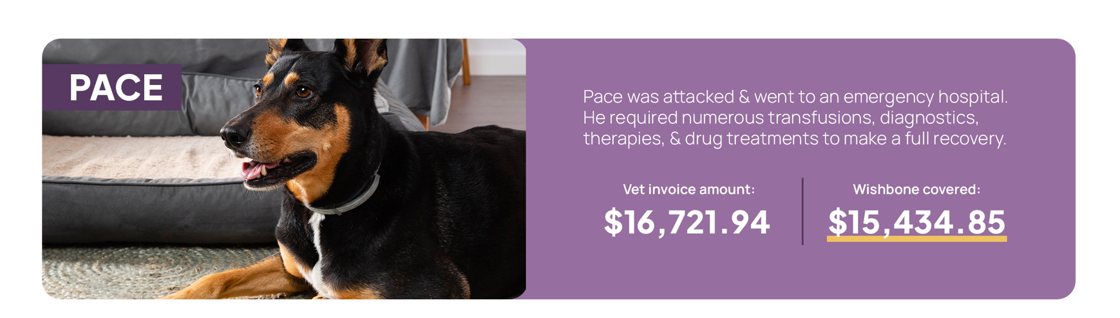
WISHBONE IS THERE
FOR YOU AND YOUR PETS
Pet Benefit Solutions | www.petbenefits.com

Slide 24
HOW TO MAXIMIZE YOUR SAVINGS
Enroll in both Total Pet Plan and Wishbone to enjoy comprehensive coverage for your entire pet family
Get peace of mind in case of accidents or illnesses. Visit any licensed U.S. vet, but save more when you visit an in-network vet
Enroll in a wellness plan to save on routine pet care like annual visits and vaccinations
Save on vet care for all your pets, even older pets and pets with pre-existing conditions
Lower pet care costs with discounts on pet care products and services you're using every day
Wishbone Pet Insurance is a pet health insurance program offered by Pet Assure Corp., dba Pet Benefit Solutions, a licensed agency (NJ License Number 1677880). Insurance coverage is administered by Pet Assure Corp., dba Pet Benefit Solutions and underwritten by Everspan Insurance Company or Providence Washington Insurance Company. Please visit https://www.wishboneinsurance.com/terms-and-conditions for more information. Wishbone’s wellness plans are not insurance and are administered by Pet Benefit Solutions.
Wishbone’s wellness plans are not insurance and are administered by Pet Benefit Solutions.
Product information is descriptive; consult your policy or member agreement for specific coverage details. Terms vary by state and are subject to change. Coverage is determined by the applicable policy. Not all options are available to all customers. In case of conflict, policy provisions prevail.

Slide 25

ENROLL IN PET BENEFITS TODAY!
One-of-a-kind pet care bundle
Up to 40% off on pet food, prescriptions, toys, treats, and more
Instant 25% discount at network veterinarians
24/7 pet telehealth
Pet tag and lost pet recovery
Accident/Illness and Wellness
Valid at any veterinary facility; save even more at an in-network vet
Comprehensive health coverage for dogs and cats
Easy online claims with fast processing
Questions? Contact Us
customercare@petbenefits.com | (800) 891-2565

